Slide 1

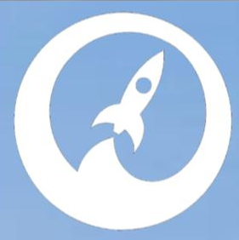
AstraCell
A Novel Approach to Space Fuel Cells

Slide 2

Space Today
1.4 T
1.7 B
5 K
Projected Space Consumerism Market by 2030
Projected Space Tourism Market by 2027
Current PEMFC Cell Lifetime

Slide 3




Our Solution
Hybrid System
Honeycomb Design
Greener Fuel
AstraCell is a hybrid enzymatic fuel cell that utilizes a honeycomb system to create a powerful and sustainable alternative for the space industry.

Slide 4




Our Value
Cheaper
Materials
Honeycomb System
Less Bulky Technology
Affordability
Efficiency
Scalability
De-Alloyed Platinum
Efficient Fuel production
Curated for Space
Regenerative Technology
Immobilized Enzymes
Space Tourism

Slide 5
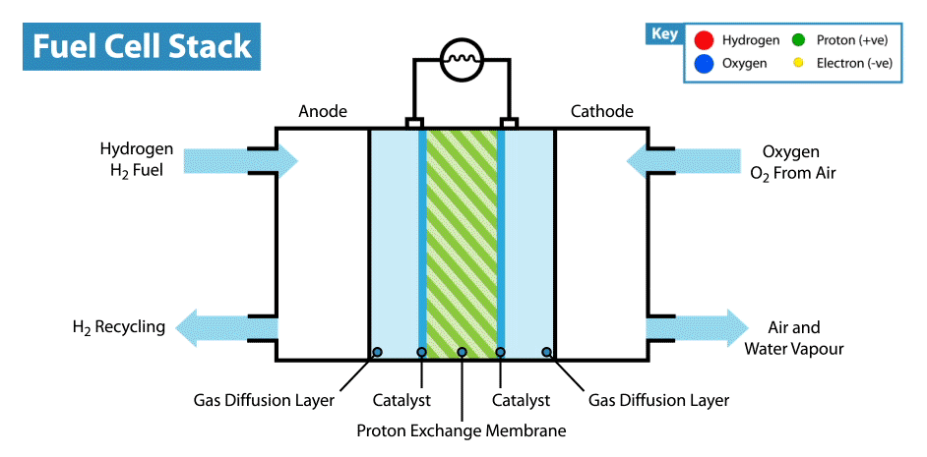

Internal Design
Animation extracted from Intelligent Energy Technology

Slide 6
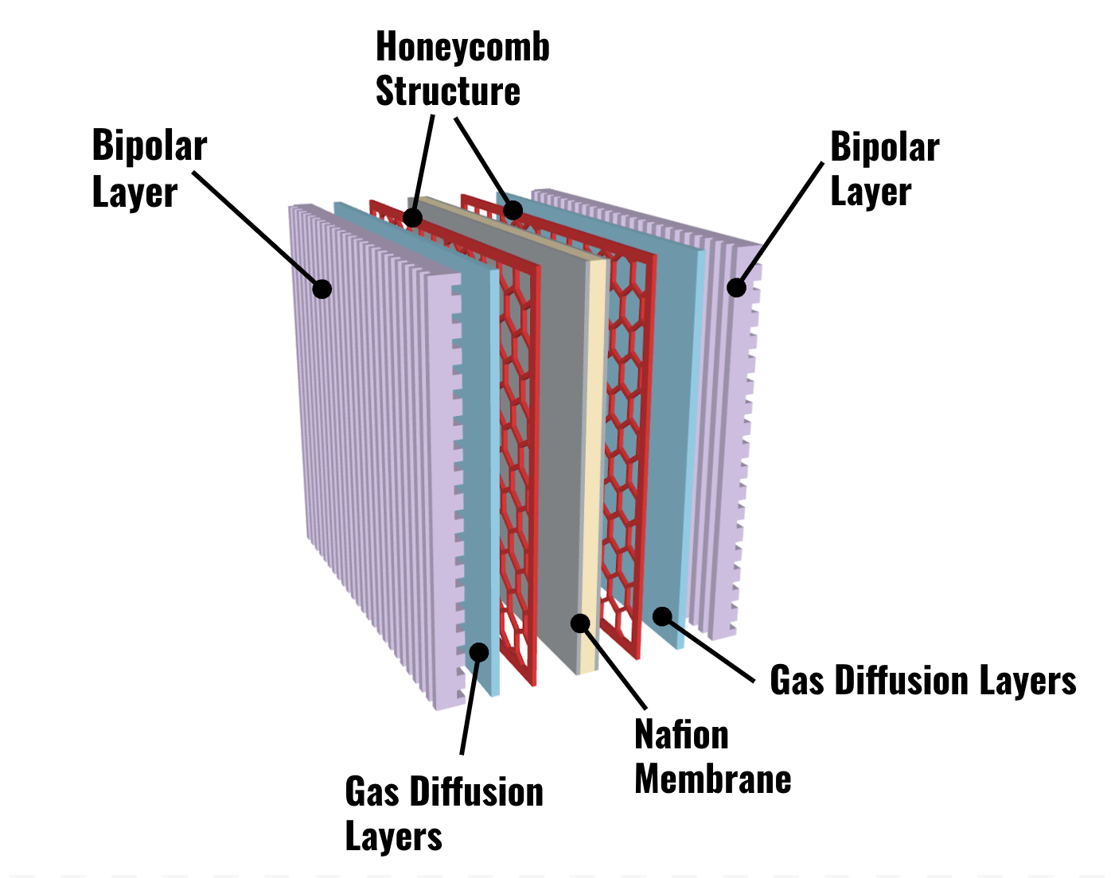
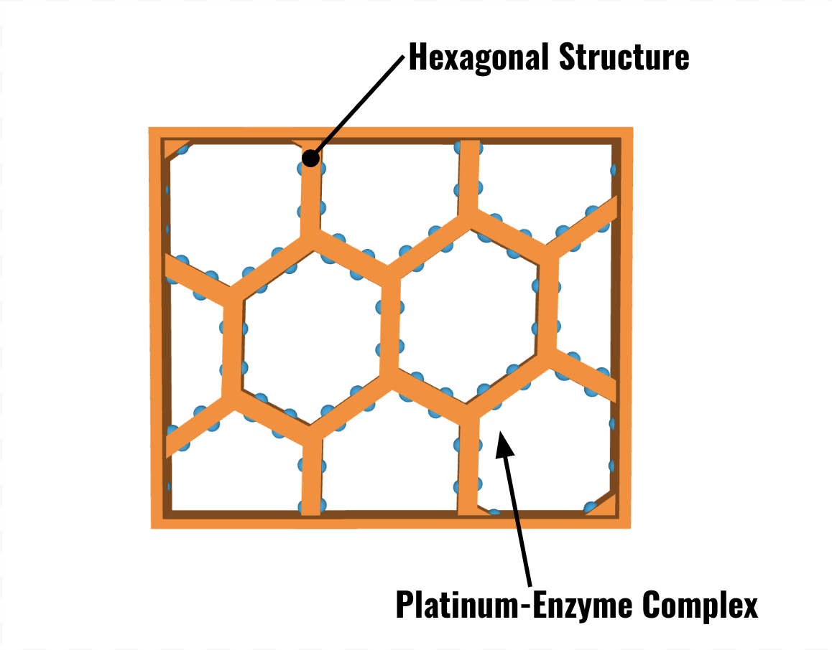
Internal Design

Slide 7
Pricing Plan
$15600
$5200
$473,280
Cost Per Aircraft
Cost Per Kg
Savings Per Launch

Slide 8



Funding Sources
Air Force Research
Laboratory
Angel Investors
NASA

Slide 9



Marketing Plan
Establish Market Ethos Through Research Publication
Sell Excess Materials
Price Match Competitors

Slide 10




Market Ingress Plan
Phase I
Phase II
Phase III
Phase IV
Gain industry credibility through further research and testing
Reach into the aerospace market and graphene (initial profit)
Begin to produce fuel cell components based on completed POC
Expanding into more biological components to achieve 100% green fuel cell
Phase I

Slide 11

“To confine our attention to terrestrial matters would be to limit the human spirit.”
- Stephen Hawking

